Slide 1
Contract Full Example

Slide 2
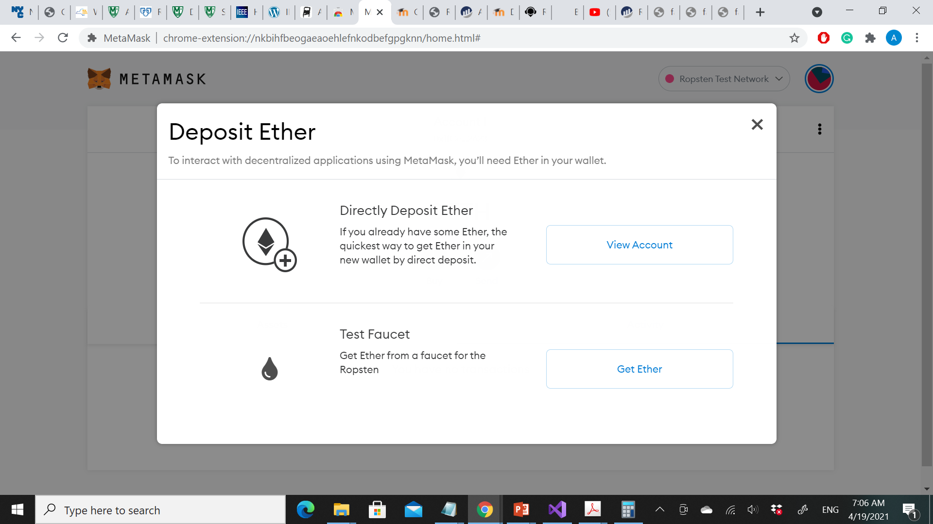
Getting Some Test Ether
Your first task is to get your wallet funded. You won’t be doing that on the main network because real ether costs money and handling it requires a bit more experience.
For now, you’ll load your wallet with some testnet ether.
Switch MetaMask to the Ropsten Test Network. Click Buy, then click Ropsten Test Faucet. MetaMask will open a new web page, as shown in the figure.
OR:
use https://faucet.ropsten.be/ to charge your wallet with 1 ether.
“Mastering Ethereum by Andreas M. Antonopoulos and Dr. Gavin Wood (O’Reilly). Copyright 2019 The Ethereum Book LLC and Gavin Wood, 978-1-491-97194-9."

Slide 3
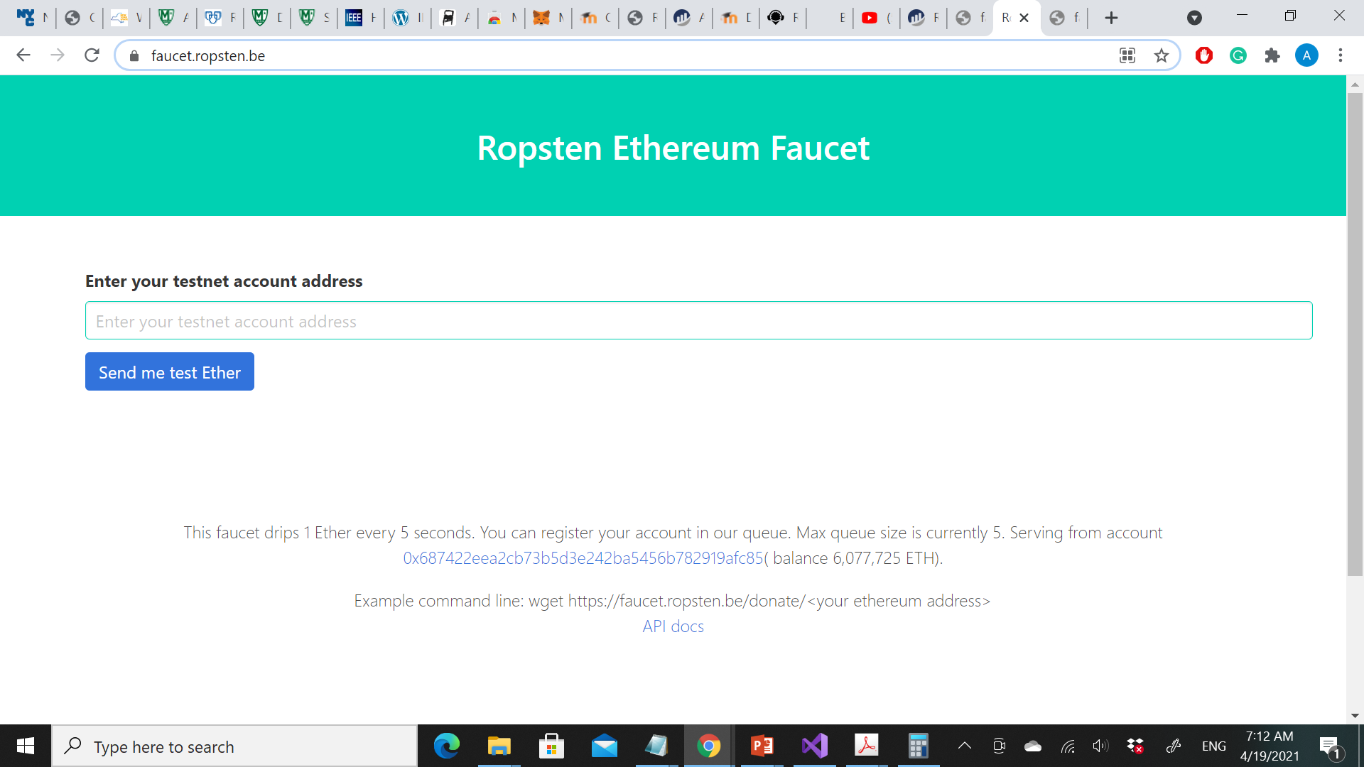

Slide 4
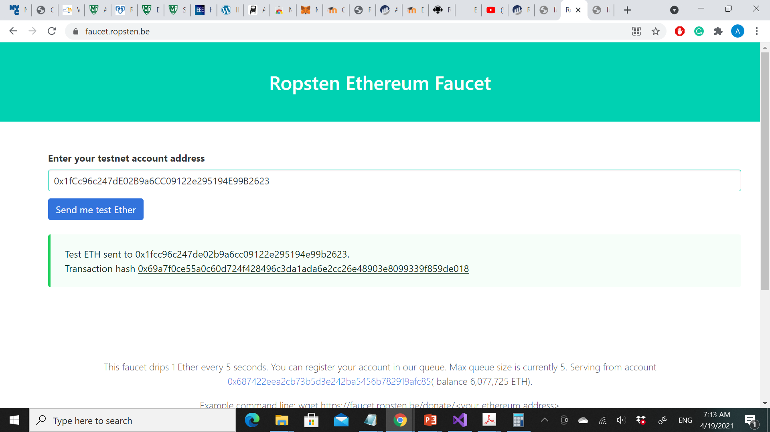

Slide 5
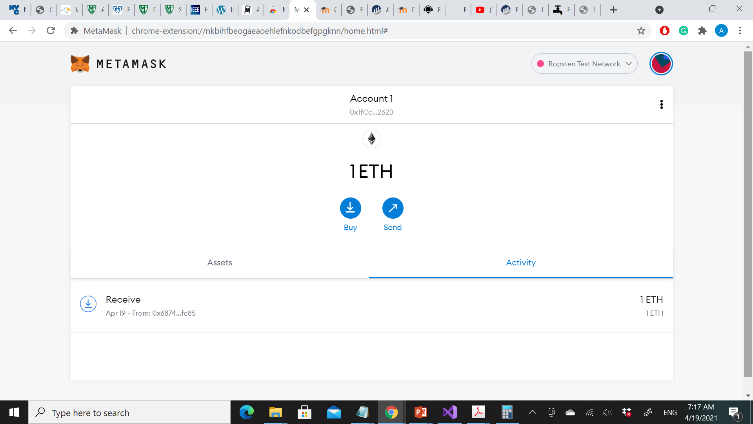
Click on the transaction ID and your browser will take you to a block explorer, which is a website that allows you to visualize and explore blocks, addresses, and transactions. MetaMask uses the Etherscan block explorer, one of the more popular Ethereum block explorers.

Slide 6
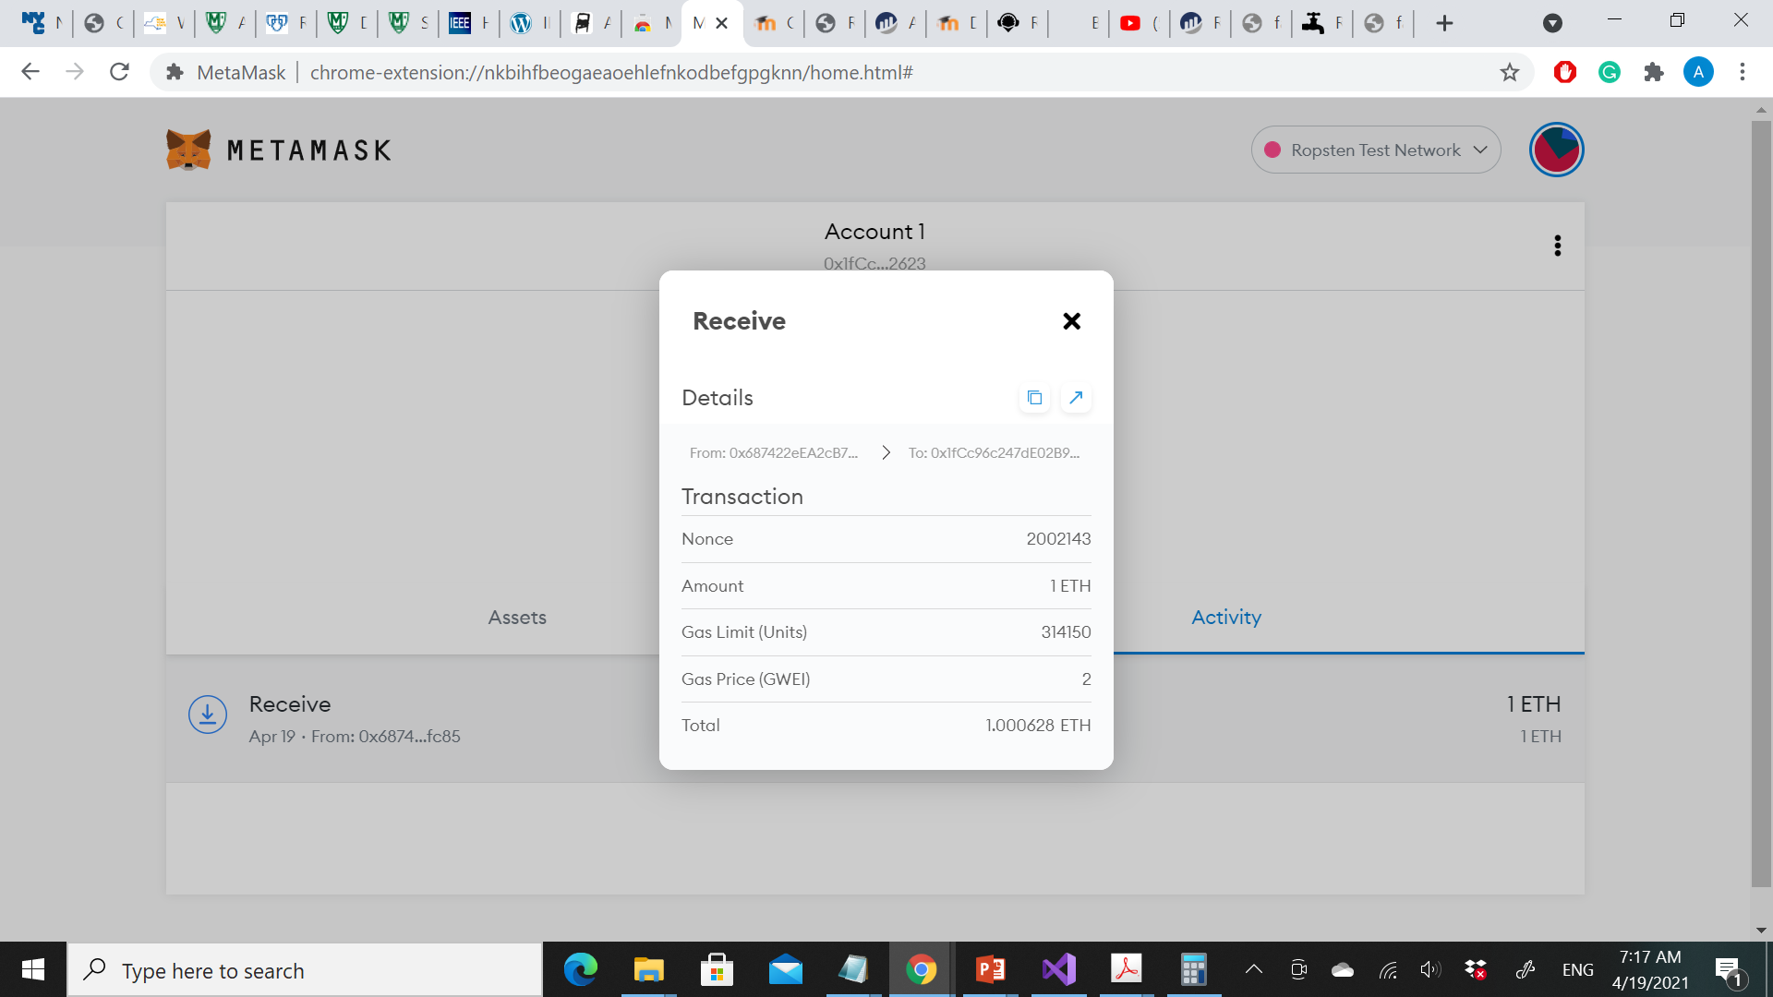

Slide 7
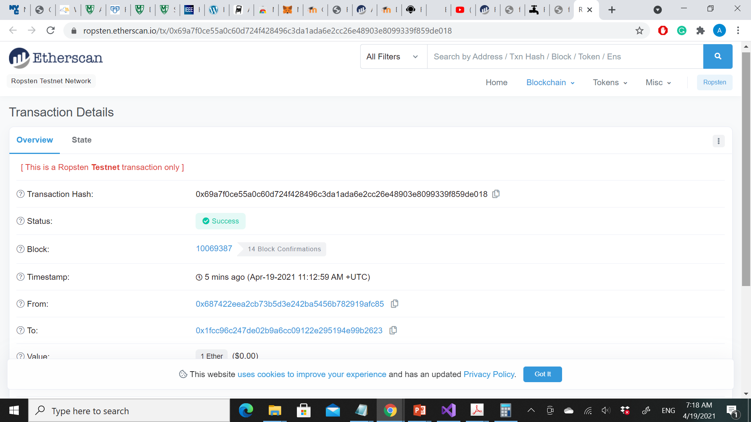

Slide 8
Externally Owned Accounts (EOAs) and Contracts
The type of account we created in the MetaMask wallet is called an externally owned account (EOA).
Externally owned accounts are those that have a private key; having the private key means control over access to funds or contracts.
A contract account has smart contract code, and does not have a private key, Instead, it is owned (and controlled) by the logic of its smart contract code.
“Mastering Ethereum by Andreas M. Antonopoulos and Dr. Gavin Wood (O’Reilly). Copyright 2019 The Ethereum Book LLC and Gavin Wood, 978-1-491-97194-9."

Slide 9
Contracts have addresses, just like EOAs. Contracts can also send and receive ether, just like EOAs. However, when a transaction destination is a contract address, it causes that contract to run in the EVM, using the transaction, and the transaction’s data, as its input.
In addition to ether, transactions can contain data indicating which specific function in the contract to run and what parameters to pass to that function. In this way, transactions can call functions within contracts.
“Mastering Ethereum by Andreas M. Antonopoulos and Dr. Gavin Wood (O’Reilly). Copyright 2019 The Ethereum Book LLC and Gavin Wood, 978-1-491-97194-9."

Slide 10
Because a contract account does not have a private key, it cannot initiate a transaction.
Only EOAs can initiate transactions, but contracts can react to transactions by calling other contracts, building complex execution paths.
“Mastering Ethereum by Andreas M. Antonopoulos and Dr. Gavin Wood (O’Reilly). Copyright 2019 The Ethereum Book LLC and Gavin Wood, 978-1-491-97194-9."

Slide 11
Example (Faucet.sol: A Solidity contract implementing a faucet)
We will write a contract that controls a faucet.
A faucet is a relatively simple thing: it gives out ether to any address that asks, and can be refilled periodically.
We can implement a faucet as a wallet controlled by a human or a web server.
“Mastering Ethereum by Andreas M. Antonopoulos and Dr. Gavin Wood (O’Reilly). Copyright 2019 The Ethereum Book LLC and Gavin Wood, 978-1-491-97194-9."

Slide 12
// SPDX-License-Identifier: CC-BY-SA-4.0
// Version of Solidity compiler this program was written for
pragma solidity 0.6.4;
// Our first contract is a faucet!
contract Faucet {
// Accept any incoming amount
receive() external payable {}
// Give out ether to anyone who asks
function withdraw(uint withdraw_amount) public {
// Limit withdrawal amount
require(withdraw_amount <= 100000000000000000);
// Send the amount to the address that requested it
msg.sender.transfer(withdraw_amount);
}
}
“Mastering Ethereum by Andreas M. Antonopoulos and Dr. Gavin Wood (O’Reilly). Copyright 2019 The Ethereum Book LLC and Gavin Wood, 978-1-491-97194-9."

Slide 13
contract Faucet {
This line declares a contract object, similar to a class declaration in other object-oriented languages.
The contract definition includes all the lines between the curly braces ( {} ), which define a scope, much like how curly braces are used in many other programming languages.
“Mastering Ethereum by Andreas M. Antonopoulos and Dr. Gavin Wood (O’Reilly). Copyright 2019 The Ethereum Book LLC and Gavin Wood, 978-1-491-97194-9."

Slide 14
receive() external payable {}
Accept any incoming amount of ether
It is usually the one that receives ether. That’s why it is defined as a external and payable function, which means it can accept ether into the contract. It doesn’t do anything, other than accept the ether, as indicated by the empty definition in the curly braces ( {} ).
If we make a transaction that sends ether to the contract address, as if it were a wallet, this function will handle it.

Slide 15
The first function of the Faucet contract: function withdraw(uint withdraw_amount) public {
The function is named withdraw, and it takes one unsigned integer (uint) argument named withdraw_amount.
It is declared as a public function, meaning it can be called by other contracts.
The function definition follows, between curly braces. The first part of the withdraw function sets a limit on withdrawals:
require(withdraw_amount <= 100000000000000000);
It uses the built-in Solidity function require to test a precondition, that the withdraw_amount is less than or equal to 100,000,000,000,000,000 wei, which is the base unit of ether and equivalent to 0.1 ether.
If the withdraw function is called with a withdraw_amount greater than that amount, the require function here will cause contract execution to stop and fail with an exception.
Note that statements need to be terminated with a semicolon in Solidity.
“Mastering Ethereum by Andreas M. Antonopoulos and Dr. Gavin Wood (O’Reilly). Copyright 2019 The Ethereum Book LLC and Gavin Wood, 978-1-491-97194-9."

Slide 16
msg.sender.transfer(withdraw_amount);
The msg object is one of the inputs that all contracts can access. It represents the transaction that triggered the execution of this contract.
The attribute sender is the sender address of the transaction.
The function transfer is a built-in function that transfers ether from the current contract to the address of the sender.
Reading it backward, this means transfer to the sender of the msg that triggered this contract execution.
The transfer function takes an amount as its only argument. We pass the withdraw_amount value that was the parameter to the withdraw function declared a few lines earlier.
“Mastering Ethereum by Andreas M. Antonopoulos and Dr. Gavin Wood (O’Reilly). Copyright 2019 The Ethereum Book LLC and Gavin Wood, 978-1-491-97194-9."

Slide 17
Compiling the Faucet Contract
Now that we have our first example contract, we need to use a Solidity compiler to convert the Solidity code into EVM bytecode so it can be executed by the EVM on the blockchain itself.
This how the bytecode looks like:
“Mastering Ethereum by Andreas M. Antonopoulos and Dr. Gavin Wood (O’Reilly). Copyright 2019 The Ethereum Book LLC and Gavin Wood, 978-1-491-97194-9."

Slide 18
Creating the Contract on the Blockchain
We’ve compiled the contract into bytecode. Now, we need to "register" the contract on the Ethereum blockchain.
We will be using the Ropsten testnet to test our contract.
Registering a contract on the blockchain involves creating a special transaction whose destination is the address 0x0000000000000000000000000000000000000000, also known as the zero address.
The zero address is a special address that tells the Ethereum blockchain that you want to register a contract. Fortunately, the Remix IDE will handle all of that for us and send the transaction to MetaMask.
“Mastering Ethereum by Andreas M. Antonopoulos and Dr. Gavin Wood (O’Reilly). Copyright 2019 The Ethereum Book LLC and Gavin Wood, 978-1-491-97194-9."

Slide 19
First, switch to the Run tab and select Injected Web3 in the Environment drop-down selection box.
This connects the Remix IDE to the MetaMask wallet, and through MetaMask to the Ropsten test network.
Once you do that, you can see Ropsten under Environment.
Also, in the Account selection box it shows the address of your wallet.
Right below the Run settings you just confirmed is the Faucet contract, ready to be created. Click on the Deploy button
“Mastering Ethereum by Andreas M. Antonopoulos and Dr. Gavin Wood (O’Reilly). Copyright 2019 The Ethereum Book LLC and Gavin Wood, 978-1-491-97194-9."

Slide 20
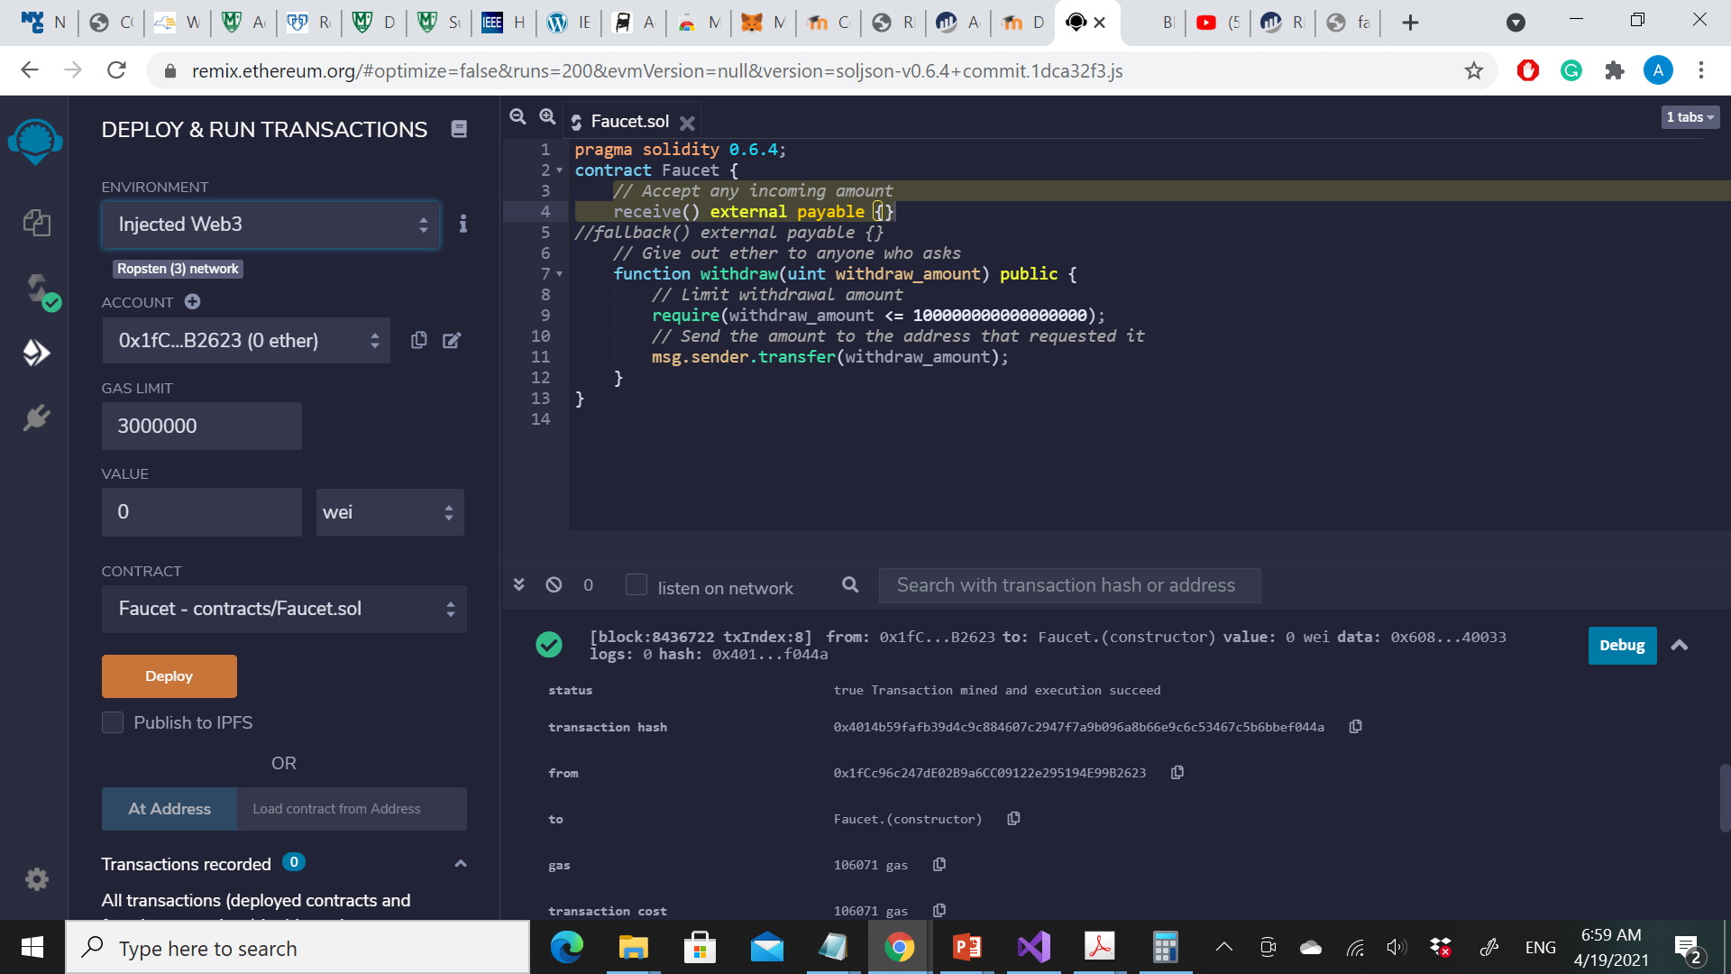

Slide 21
Remix will construct the special "creation" transaction and MetaMask will ask you to approve it.
You’ll notice the contract creation transaction has no ether in it, but it has 258 bytes of data (the compiled contract) and will consume 10 gwei in gas. Click Submit to approve it.
“Mastering Ethereum by Andreas M. Antonopoulos and Dr. Gavin Wood (O’Reilly). Copyright 2019 The Ethereum Book LLC and Gavin Wood, 978-1-491-97194-9."

Slide 22
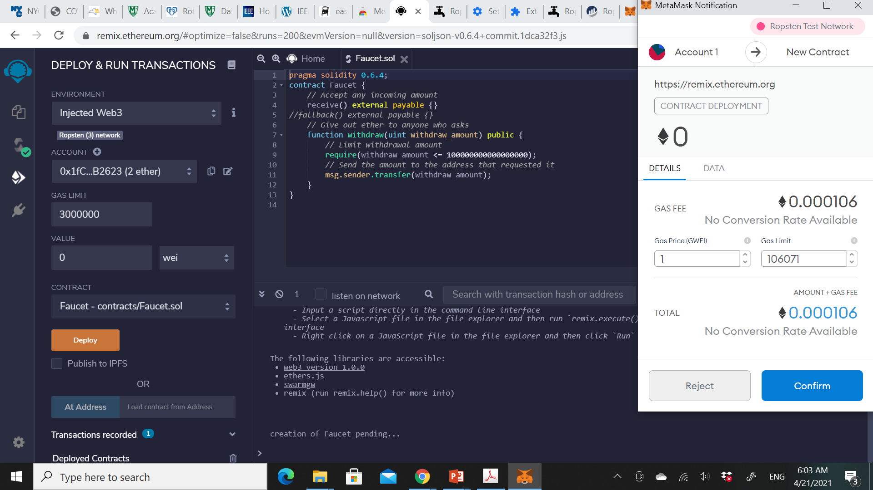

Slide 23
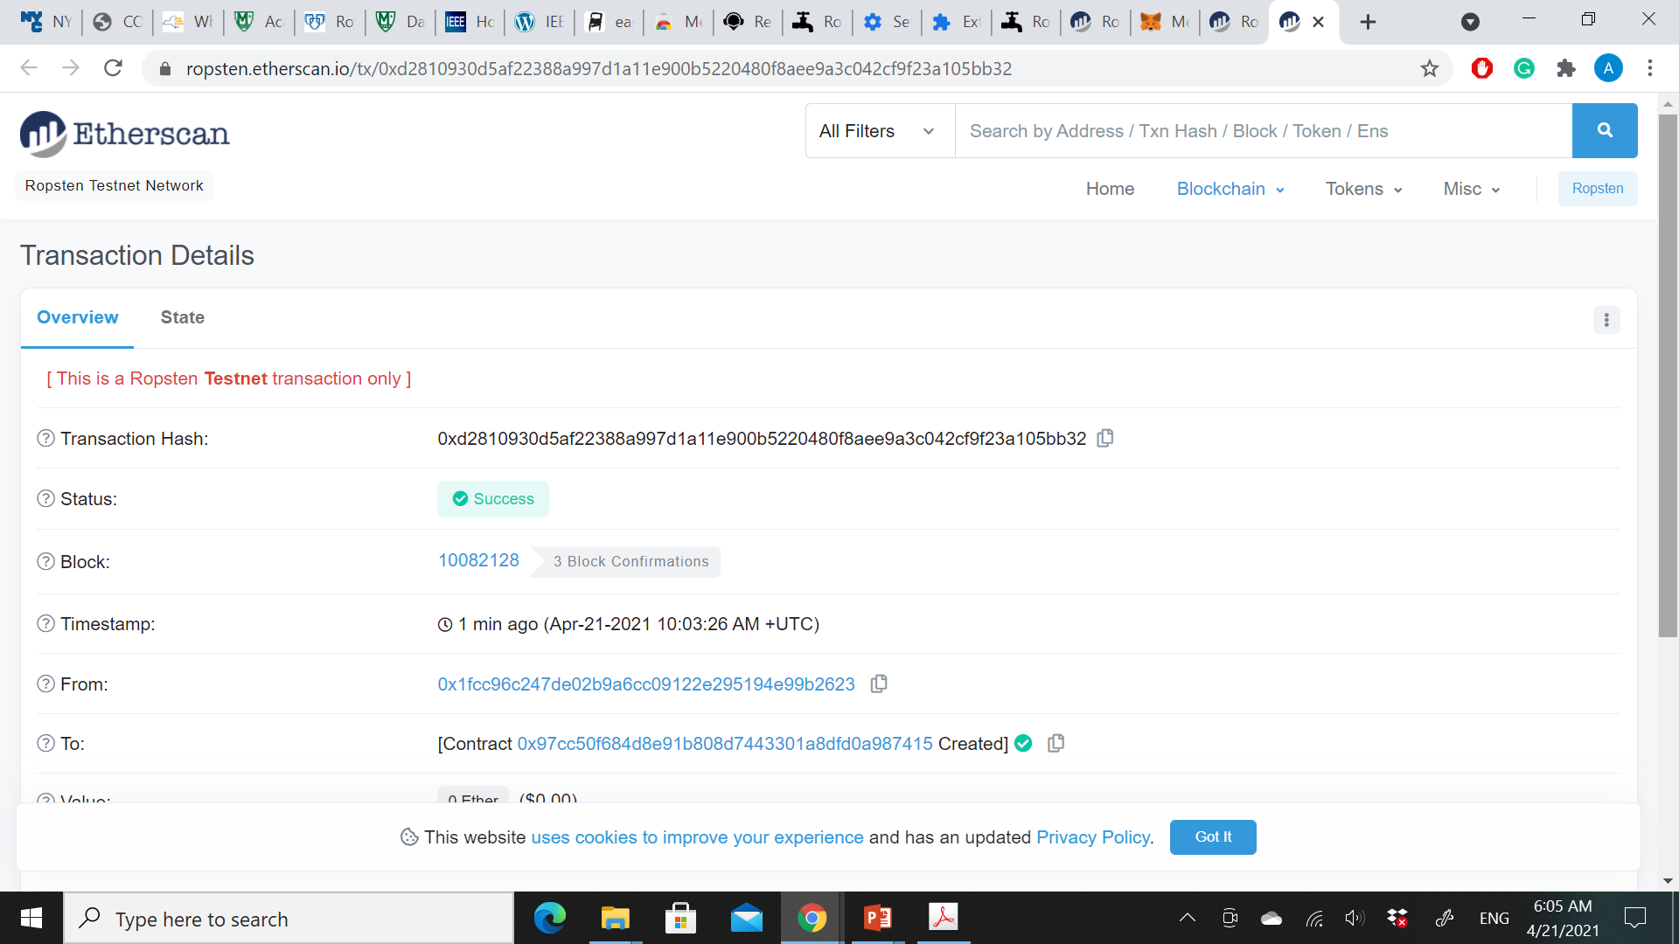

Slide 24
It will take about 15 to 30 seconds for the contract to be mined on Ropsten. Remix won’t appear to be doing much.
Once the contract is created, it appears at the bottom of the Run tab.
Notice that the Faucet contract now has an address of its own: Remix shows it as “Faucet at 0x72e…c7829” (your address will be different).
The small clipboard symbol to the right allows you to copy the contract address to your clipboard. We will use that in the next section.
“Mastering Ethereum by Andreas M. Antonopoulos and Dr. Gavin Wood (O’Reilly). Copyright 2019 The Ethereum Book LLC and Gavin Wood, 978-1-491-97194-9."

Slide 25
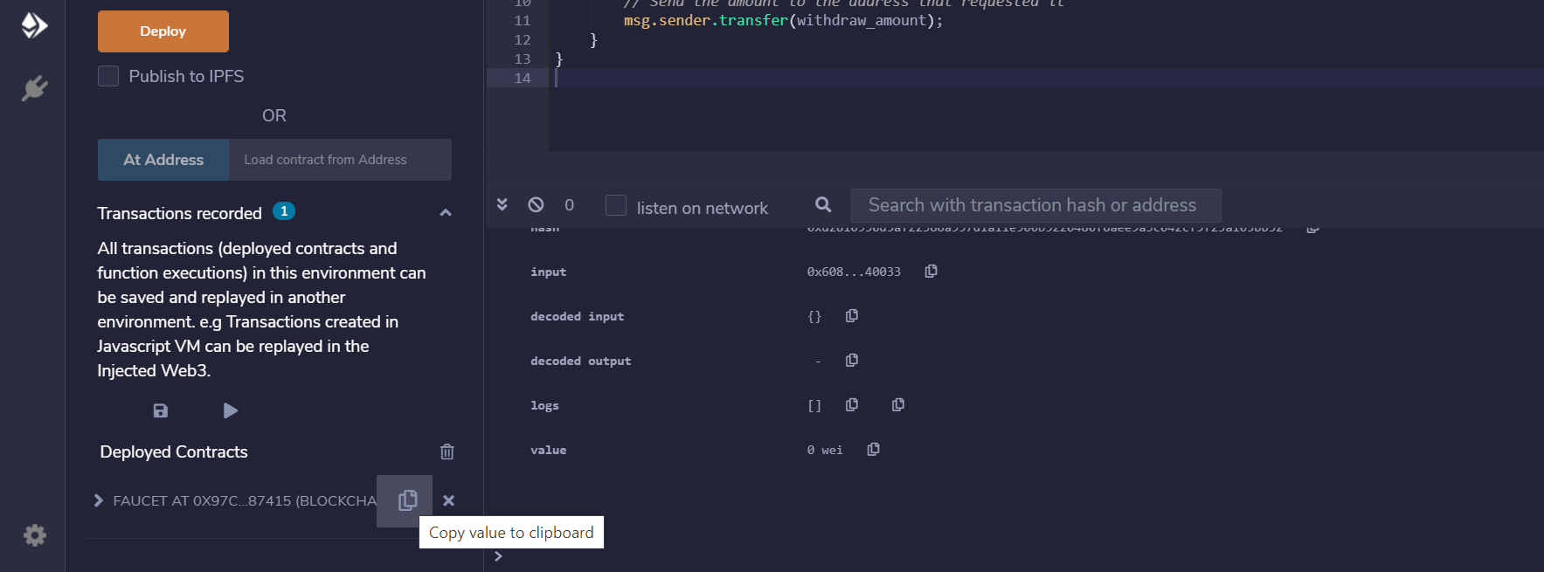

Slide 26
Interacting with the Contract
Ethereum contracts are programs that control money, which run inside a virtual machine called the EVM.
They are created by a special transaction that submits their bytecode to be recorded on the blockchain. Once they are created on the blockchain, they have an Ethereum address, just like wallets.
Anytime someone sends a transaction to a contract address it causes the contract to run in the EVM, with the transaction as its input.
Transactions sent to contract addresses may have ether or data or both. If they contain ether, it is “deposited” to the contract balance. If they contain data, the data can specify a named function in the contract and call it, passing arguments to the function.
“Mastering Ethereum by Andreas M. Antonopoulos and Dr. Gavin Wood (O’Reilly). Copyright 2019 The Ethereum Book LLC and Gavin Wood, 978-1-491-97194-9."

Slide 27
Viewing the Contract Address in a Block Explorer
We now have a contract recorded on the blockchain, and we can see it has an Ethereum address.
We can check it out in the ropsten.etherscan.io block explorer and see what a contract looks like.
In the Remix IDE, copy the address of the contract by clicking the clipboard icon next to its name and navigate your browser to ropsten.etherscan.io and paste the address into the search box.
You should see the contract’s Ethereum address history.
“Mastering Ethereum by Andreas M. Antonopoulos and Dr. Gavin Wood (O’Reilly). Copyright 2019 The Ethereum Book LLC and Gavin Wood, 978-1-491-97194-9."

Slide 28
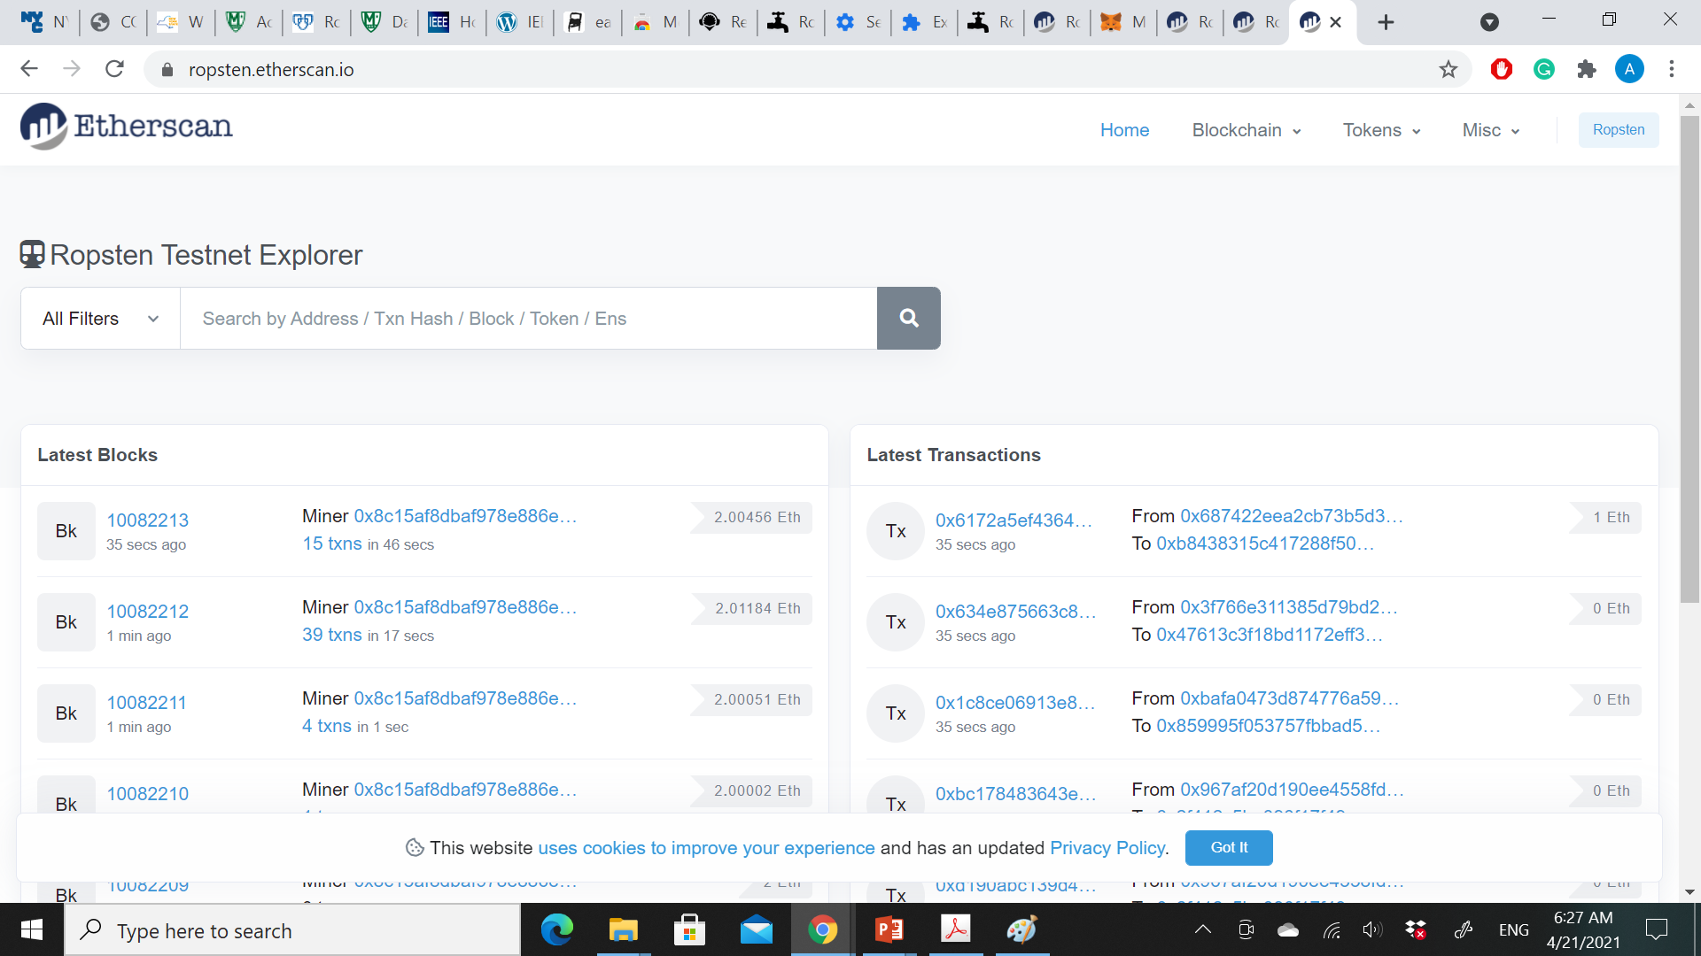

Slide 29
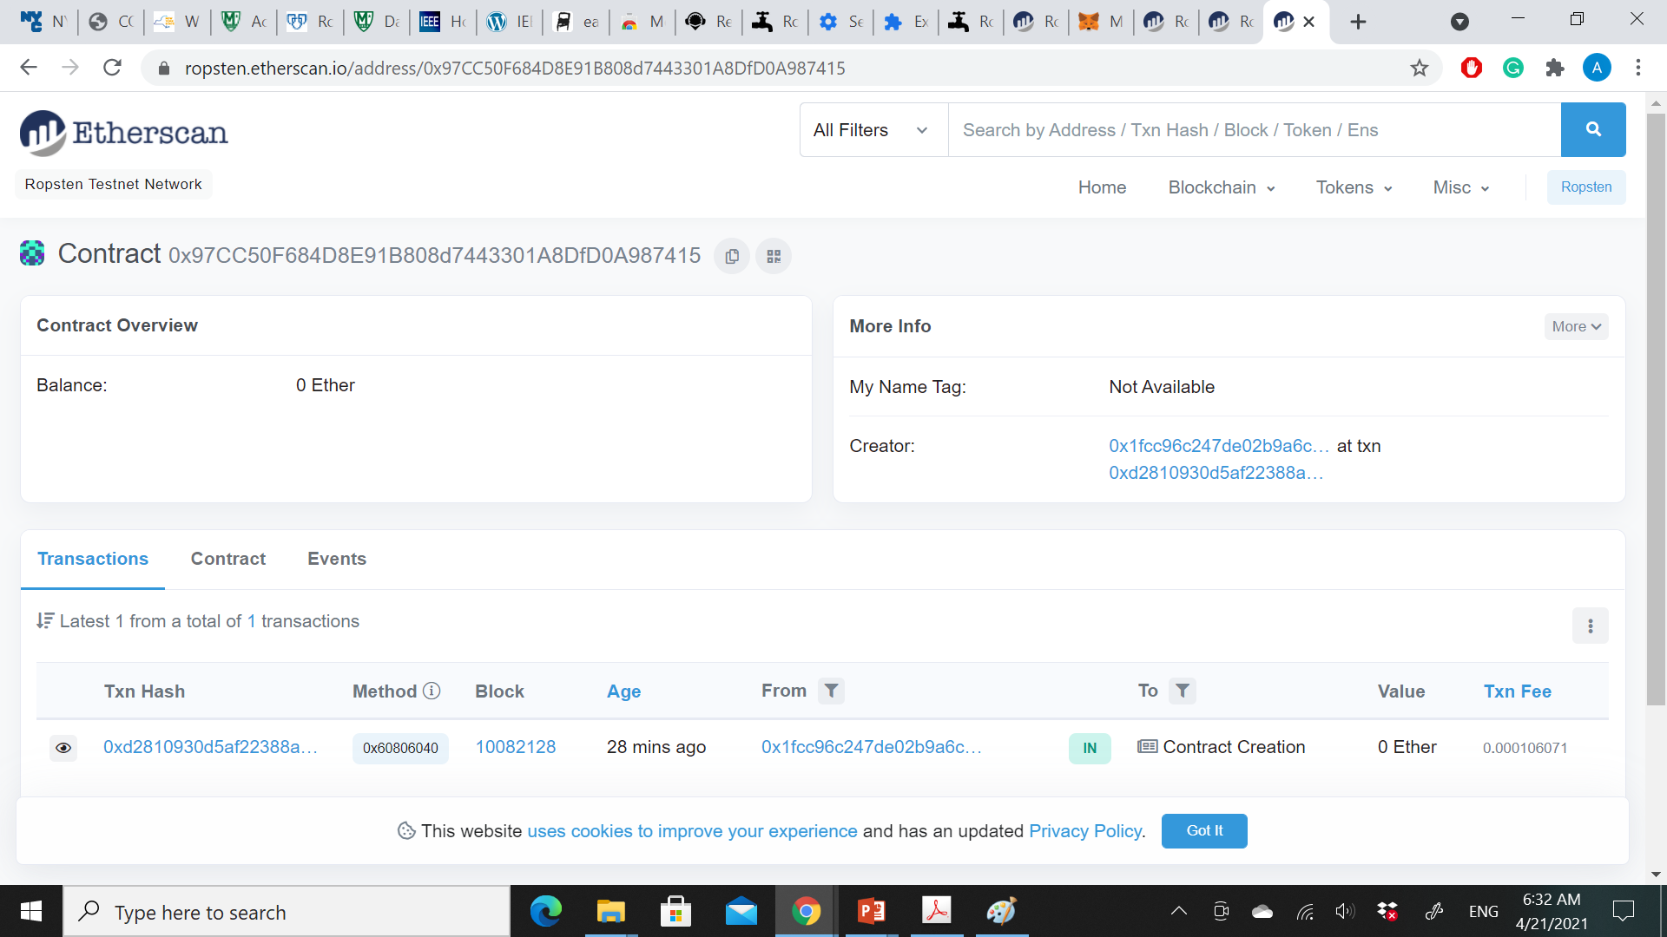

Slide 30
Funding the Contract
For now, the contract only has one transaction in its history: the contract creation transaction.
Also, the contract also has no ether (zero balance). That’s because we didn’t send any ether to the contract in the creation transaction, even though we could have.
Our faucet needs funds! Our first project will be to use MetaMask to send ether to the contract. You should still have the address of the contract in your clipboard (if not, copy it again from Remix).
Open MetaMask, and send 1 ether to it, exactly as you would to any other Ethereum address.
“Mastering Ethereum by Andreas M. Antonopoulos and Dr. Gavin Wood (O’Reilly). Copyright 2019 The Ethereum Book LLC and Gavin Wood, 978-1-491-97194-9."

Slide 31
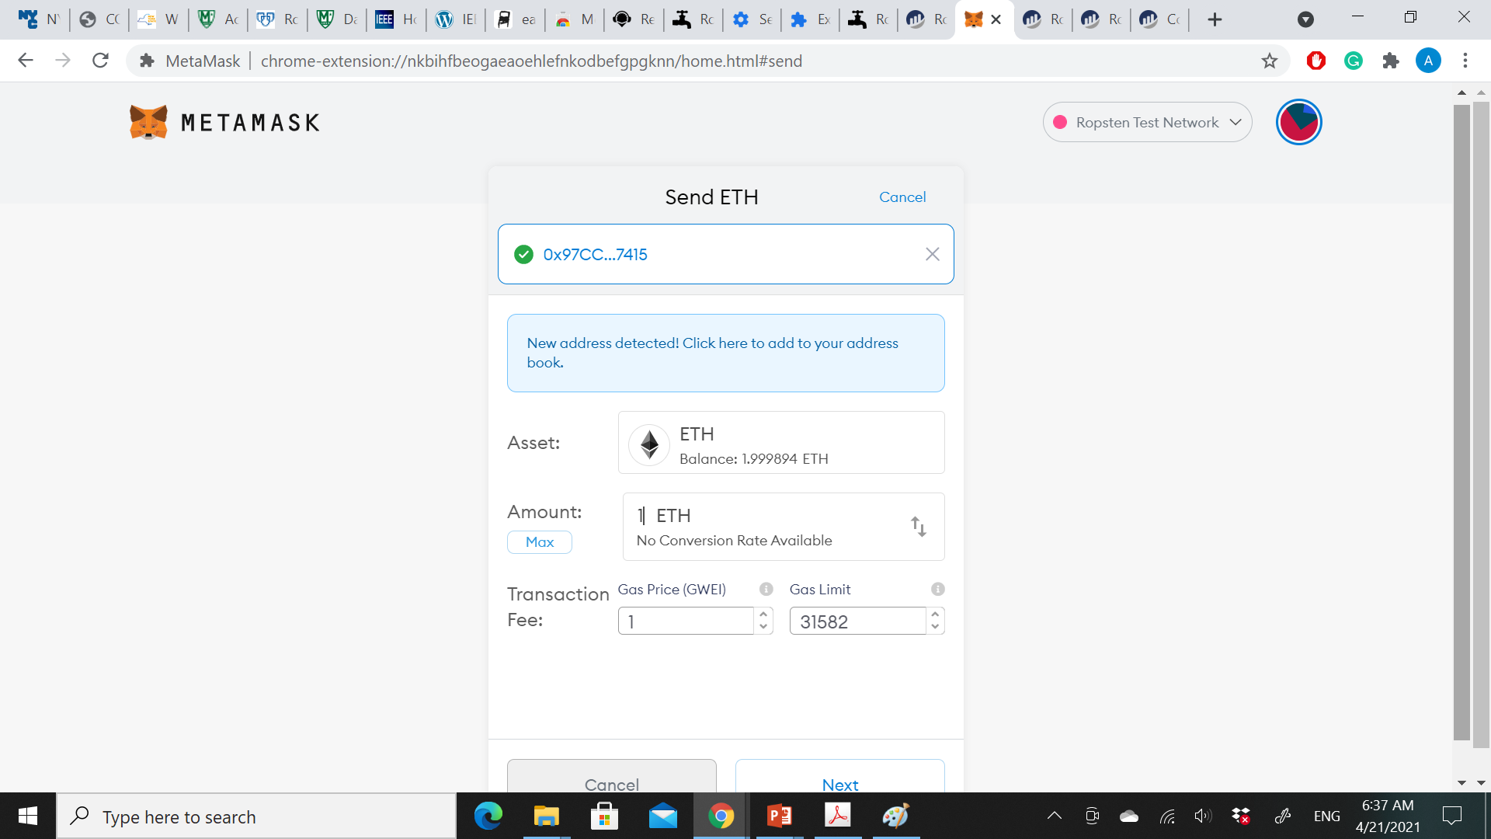

Slide 32
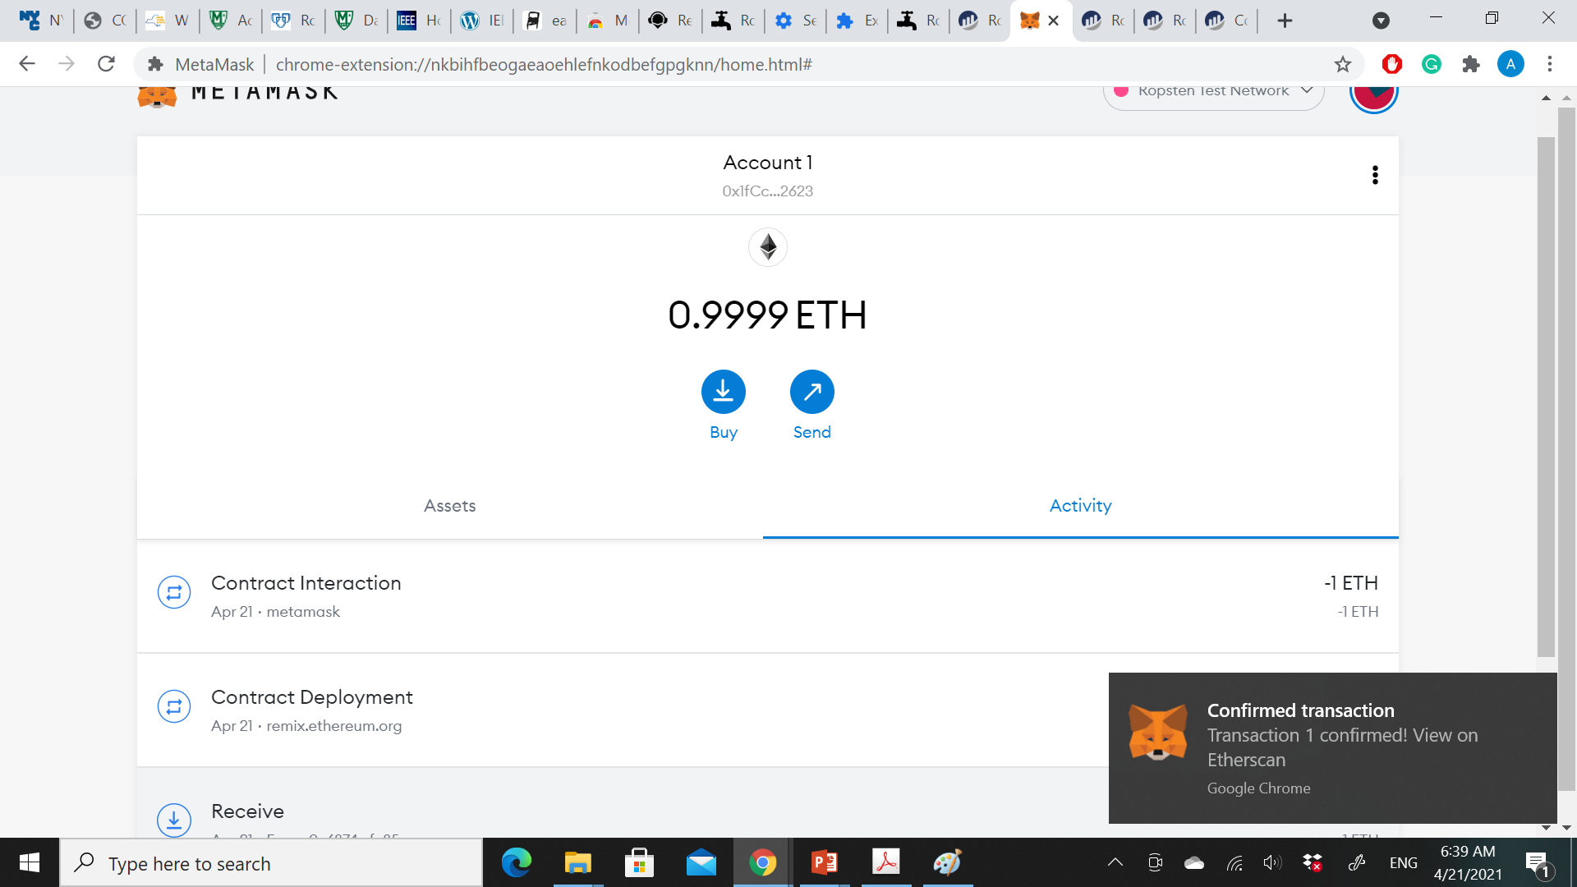

Slide 33
If you reload the Etherscan block explorer, it will show another transaction to the contract address and an updated balance of 1 ether.
The unnamed default public payable function in our Faucet.sol code:
function () public payable {}
When you sent a transaction to the contract address, with no data specifying which function to call, it called this default function.
Because we declared it as payable, it accepted and deposited the 1 ether into the contract’s account balance.
Your transaction caused the contract to run in the EVM, updating its balance. You have funded your faucet!
“Mastering Ethereum by Andreas M. Antonopoulos and Dr. Gavin Wood (O’Reilly). Copyright 2019 The Ethereum Book LLC and Gavin Wood, 978-1-491-97194-9."

Slide 34
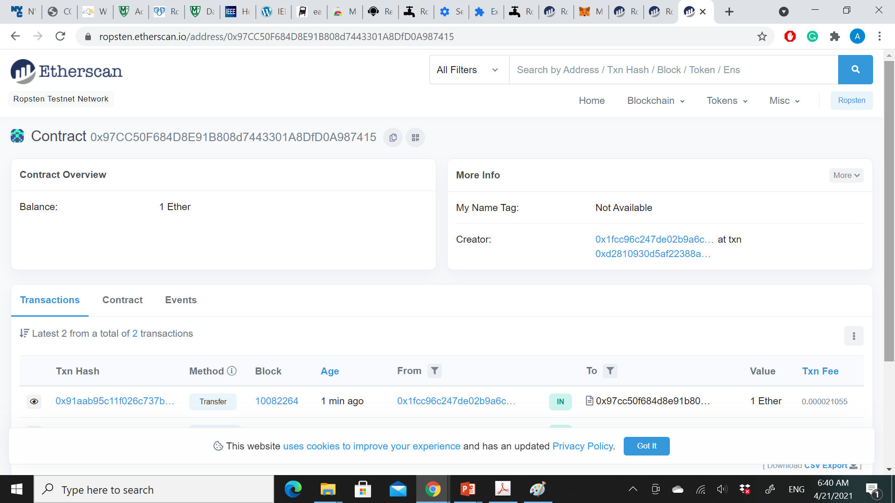

Slide 35
Withdrawing from Our Contract
To withdraw, we have to construct a transaction that calls the withdraw function and passes a withdraw_amount argument to it.
To keep things simple for now, Remix will construct that transaction for us and MetaMask will present it for our approval.
Return to the Remix tab and look at the contract on the Run tab. You should see a orange box labeled withdraw with a field entry labeled uint256 withdraw_amount.
This is the Remix interface to the contract. It allows us to construct transactions that call the functions defined in the contract.
We will enter a withdraw_amount and click the withdraw button to generate the transaction.
“Mastering Ethereum by Andreas M. Antonopoulos and Dr. Gavin Wood (O’Reilly). Copyright 2019 The Ethereum Book LLC and Gavin Wood, 978-1-491-97194-9."

Slide 36
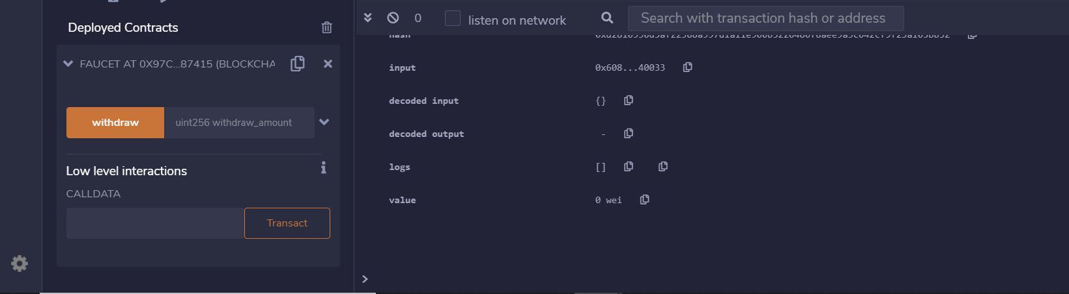

Slide 37
We want to try and withdraw 0.1 ether, which is the maximum amount allowed by our contract.
Remember that all currency values in Ethereum are denominated in wei internally, and our withdraw function expects the withdraw_amount to be denominated in wei too.
The amount we want is 0.1 ether, which is 100,000,000,000,000,000 wei (a 1 followed by 17 zeros).
Due to a limitation in JavaScript, a number as large as 10^17 cannot be processed by Remix. Instead, we enclose it in double quotes, to allow Remix to receive it as a string and manipulate it as a BigNumber. If we don’t enclose it in quotes, the Remix IDE will fail to process it and display “Error encoding arguments: Error: Assertion failed.”
Type “100000000000000000” (with the quotes) into the withdraw_amount box and click on the withdraw button, MetaMask will pop up a transaction window for you to approve. Click Submit to send your withdrawal call to the contract.
“Mastering Ethereum by Andreas M. Antonopoulos and Dr. Gavin Wood (O’Reilly). Copyright 2019 The Ethereum Book LLC and Gavin Wood, 978-1-491-97194-9."

Slide 38
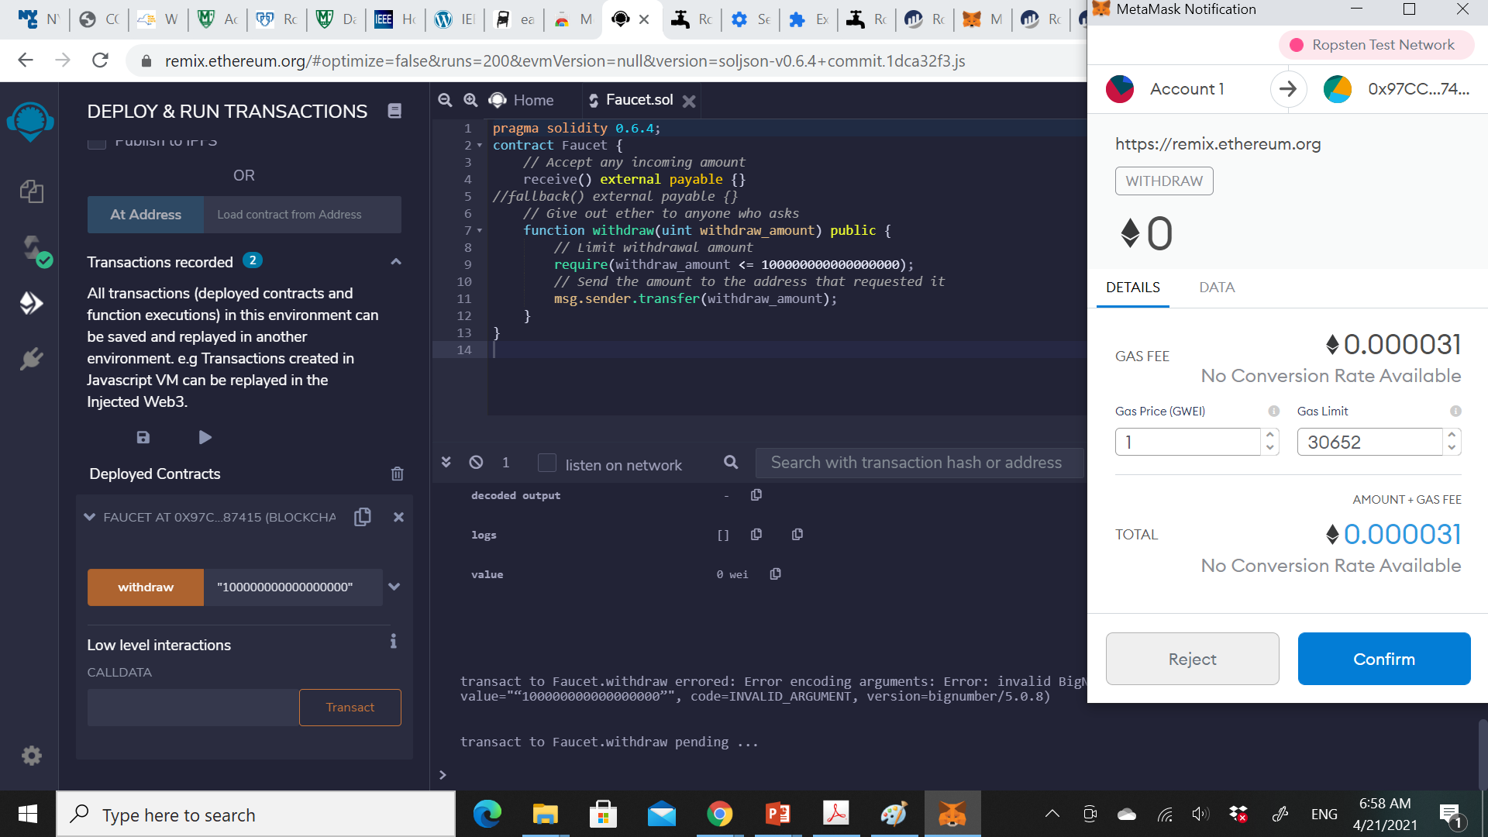

Slide 39
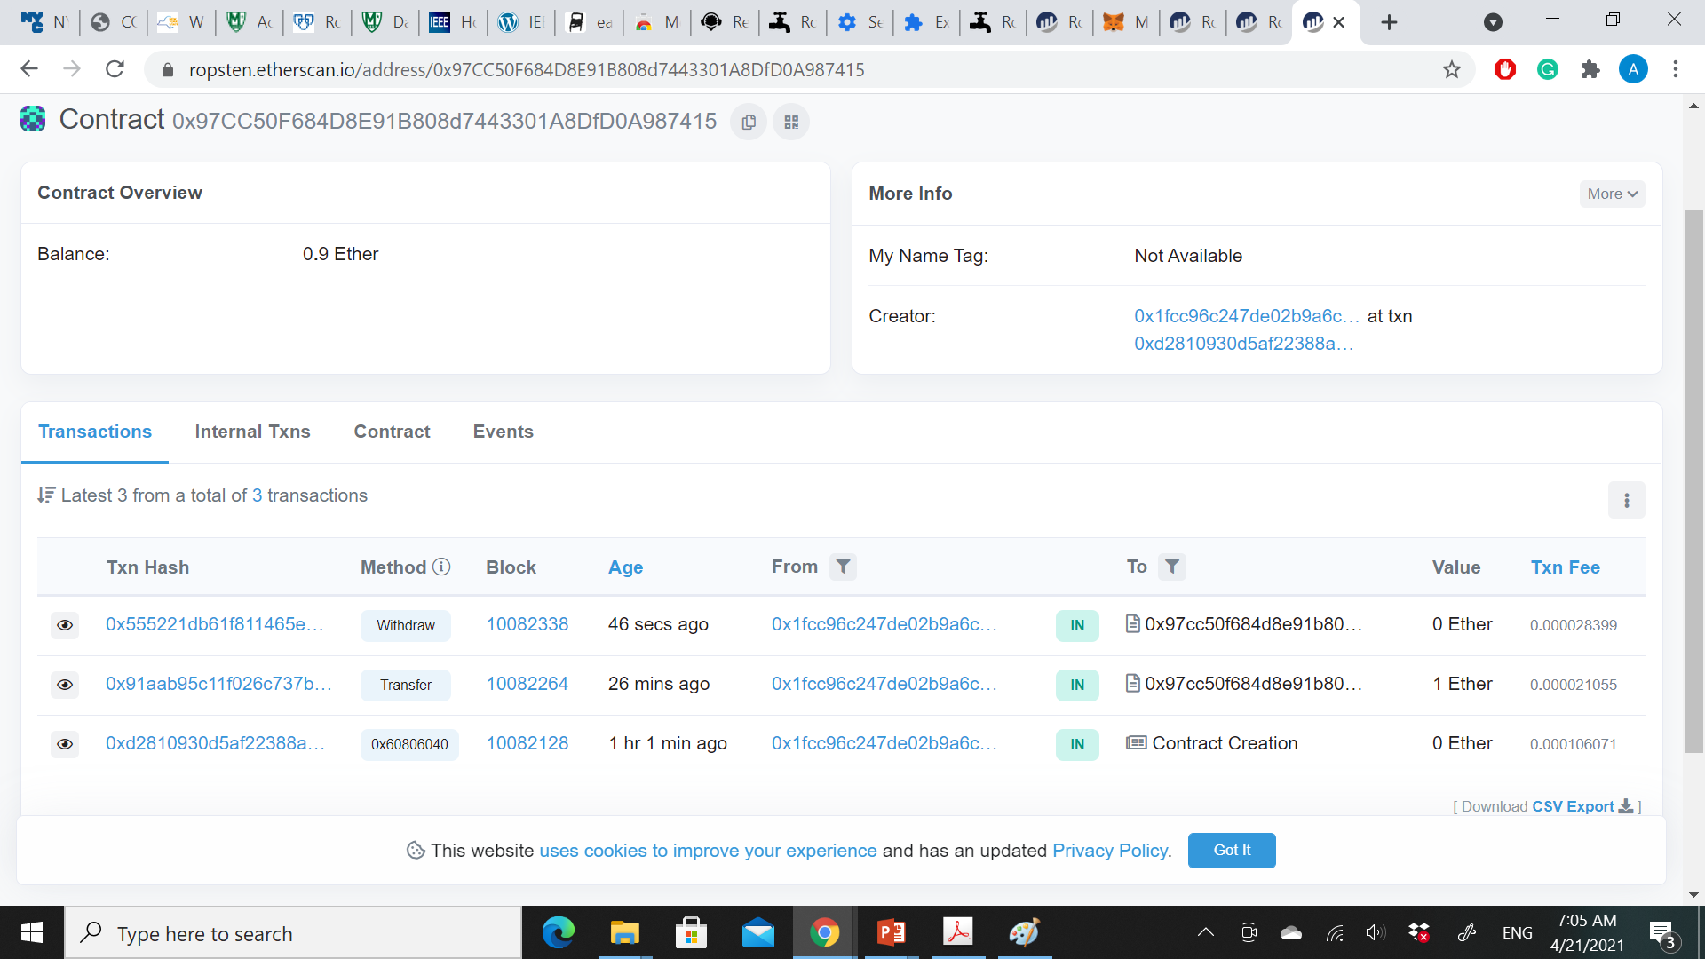
Wait a minute and then reload the Etherscan block explorer to see the transaction reflected in the Faucet contract address history.

Slide 40
We now see a new transaction with the contract address as the destination and a value of 0 ether.
The contract balance has changed and is now 0.9 ether because it sent us 0.1 ether as requested. But we don’t see an “OUT” transaction in the contract address history.
A new tab has appeared on the contract’s address history page, named Internal Transactions. Because the 0.1 ether transfer originated from the contract code, it is an internal transaction (also called a message). Click on that tab to see it.
This “internal transaction” was sent by the contract in this line of code (from the withdraw function in Faucet.sol):
msg.sender.transfer(withdraw_amount);
“Mastering Ethereum by Andreas M. Antonopoulos and Dr. Gavin Wood (O’Reilly). Copyright 2019 The Ethereum Book LLC and Gavin Wood, 978-1-491-97194-9."

Slide 41
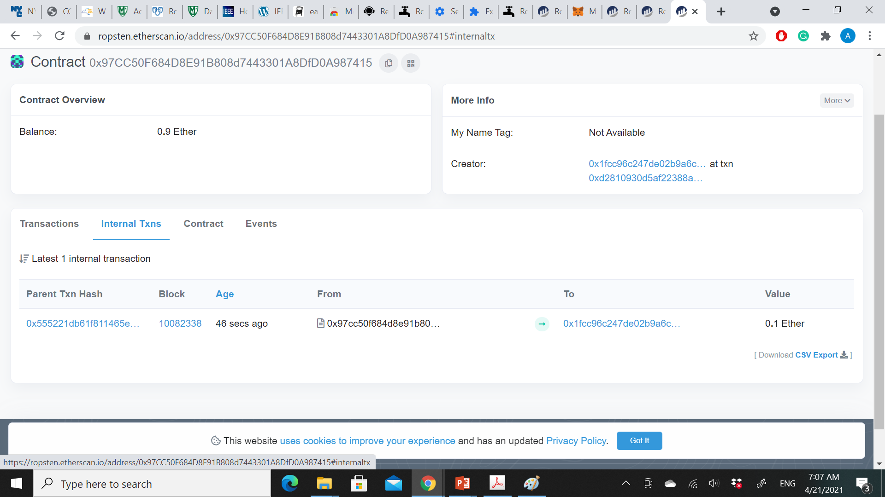

Slide 42
Summary
you sent a transaction from your MetaMask wallet that contained data instructions to call the withdraw function with a withdraw_amount argument of 0.1 ether.
That transaction caused the contract to run inside the EVM.
As the EVM ran the Faucet contract’s withdraw function, first it called the require function and validated that the requested amount was less than or equal to the maximum allowed withdrawal of 0.1 ether.
Then it called the transfer function to send you the ether.
Running the transfer function generated an internal transaction that deposited 0.1 ether into your wallet address, from the contract’s balance. That’s the one shown on the Internal Transactions tab in Etherscan.
“Mastering Ethereum by Andreas M. Antonopoulos and Dr. Gavin Wood (O’Reilly). Copyright 2019 The Ethereum Book LLC and Gavin Wood, 978-1-491-97194-9."

Slide 43
Ethereum Clients
An Ethereum client is a software application that implements the Ethereum specification and communicates over the peer-to-peer network with other Ethereum clients.
Different Ethereum clients interoperate if they comply with the reference specification and the standardized communications protocols.
Ethereum is an open source project, and the source code for all the major clients is available under open source licenses (e.g., LGPL v3.0), free to download and use for any purpose.
“Mastering Ethereum by Andreas M. Antonopoulos and Dr. Gavin Wood (O’Reilly). Copyright 2019 The Ethereum Book LLC and Gavin Wood, 978-1-491-97194-9."

Slide 44
Ethereum Networks
There exist a variety of Ethereum-based networks that largely conform to the formal specification defined in the Ethereum Yellow Paper, but which may or may not interoperate with each other.
Among these Ethereum-based networks are Ethereum, Ethereum Classic, Ella, Expanse, Ubiq, Musicoin, and many others.
While mostly compatible at the protocol level, these networks often have features or attributes that require maintainers of Ethereum client software to make small changes in order to support each network.
Because of this, not every version of Ethereum client software runs every Ethereum-based blockchain.
“Mastering Ethereum by Andreas M. Antonopoulos and Dr. Gavin Wood (O’Reilly). Copyright 2019 The Ethereum Book LLC and Gavin Wood, 978-1-491-97194-9."

Slide 45
Currently, there are six main implementations of the Ethereum protocol, written in six different languages:
Parity, written in Rust
Geth, written in Go
cpp-ethereum, written in C++
pyethereum, written in Python
Mantis, written in Scala
Harmony, written in Java
“Mastering Ethereum by Andreas M. Antonopoulos and Dr. Gavin Wood (O’Reilly). Copyright 2019 The Ethereum Book LLC and Gavin Wood, 978-1-491-97194-9."

Slide 46
Remote Client
Running a full node will incur a cost in hardware resources and bandwidth. A full node must download 80–100 GB of data (as of September 2018, depending on the client configuration)
A remote client: does not store a local copy of the blockchain or validate blocks and transactions. These clients offer the functionality of a wallet and can create and broadcast transactions.
Remote clients can be used to connect to existing networks, such as your own full node, a public blockchain, a public or permissioned (proof-of-authority) testnet, or a private local blockchain.
“Mastering Ethereum by Andreas M. Antonopoulos and Dr. Gavin Wood (O’Reilly). Copyright 2019 The Ethereum Book LLC and Gavin Wood, 978-1-491-97194-9."

Slide 47
In practice, you will likely use a remote client such as MetaMask, Emerald Wallet, MyEtherWallet, or MyCrypto as a convenient way to switch between all of the different node options.
Usually, a remote client offers an API (such as the web3.js API) in addition to the transaction functionality of a wallet.
Ethereum remote clients do not validate block headers or transactions. They entirely trust a full client to give them access to the blockchain, and hence lose significant security and anonymity guarantees. You can mitigate these problems by using a full client you run yourself.
“Mastering Ethereum by Andreas M. Antonopoulos and Dr. Gavin Wood (O’Reilly). Copyright 2019 The Ethereum Book LLC and Gavin Wood, 978-1-491-97194-9."

Slide 48
Full Node Advantages and Disadvantages
Advantages:
Disadvantages:
Supports the resilience and censorship resistance of Ethereum-based networks
Authoritatively validates all transactions
Can interact with any contract on the public blockchain without an intermediary
Can directly deploy contracts into the public blockchain without an intermediary
Can query (read-only) the blockchain status (accounts, contracts, etc.) offline
Can query the blockchain without letting a third party know the information you’re reading
Requires significant and growing hardware and bandwidth resources
May require several days to fully sync when first started
Must be maintained, upgraded, and kept online to remain synced
“Mastering Ethereum by Andreas M. Antonopoulos and Dr. Gavin Wood (O’Reilly). Copyright 2019 The Ethereum Book LLC and Gavin Wood, 978-1-491-97194-9."

Slide 49
Public Testnet Advantages and Disadvantages
Advantages:
Disadvantages:
A testnet node needs to sync and store much less data — about 10 GB depending on the network (as of April 2018).
A testnet node can sync fully in a few hours.
Deploying contracts or making transactions requires test ether, which has no value and can be acquired for free from several “faucets.”
Testnets are public blockchains with many other users and contracts, running “live.”
You can’t use “real” money on a testnet; it runs on test ether. Consequently, you can’t test security against real adversaries, as there is nothing at stake.
Transaction fees, although necessary to send transactions, are not a consideration on a testnet, since gas is free.
The testnets do not experience network congestion like the public mainnet sometimes does.
“Mastering Ethereum by Andreas M. Antonopoulos and Dr. Gavin Wood (O’Reilly). Copyright 2019 The Ethereum Book LLC and Gavin Wood, 978-1-491-97194-9."

Slide 50
Local Blockchain Simulation Advantages and Disadvantages
For many testing purposes, the best option is to launch a single-instance private blockchain.
Ganache (formerly named testrpc) is one of the most popular local blockchain simulations that you can interact with, without any other participants.
Advantages:
Disadvantages:
No syncing and almost no data on disk; you mine the first block yourself
No need to obtain test ether; you “award” yourself mining rewards that you can use for testing
No other users, just you
No other contracts, just the ones you deploy after you launch it
Having no other users means that it doesn’t behave the same as a public blockchain. There’s no competition for transaction space or sequencing of transactions.
No miners other than you means that mining is more predictable; therefore, you can’t test some scenarios that occur on a public blockchain.
Having no other contracts means you have to deploy everything that you want to test, including dependencies and contract libraries.
You can’t recreate some of the public contracts and their addresses to test some scenarios (e.g., the DAO contract).
“Mastering Ethereum by Andreas M. Antonopoulos and Dr. Gavin Wood (O’Reilly). Copyright 2019 The Ethereum Book LLC and Gavin Wood, 978-1-491-97194-9."

